Slide 1
CALMS 2012 3
Independent platform for ongoing
optimisation for energy utilities
SYSTEMS: compressed air, air cooling, steam, electricity, gas, water
August, 2020

Slide 2
The vision and mission of CALMS
Vision
Create the largest independent online energy optimization platform in the industry, connecting energy system users with professionals, equipment / service suppliers and energy solution investors
Mission
Changing the classic market model in industrial energy
Goals
Become a global leading independent platform for optimizing energy media with a focus on compressed air.

Slide 3
Connecting end-users, service providers, experts, ESCO investors and suppliers OEM on one place.
Advanced software web platform for optimization, analysis and management of energy media
MAIN BENEFITS
Generator of business opportunities
Tools for optimizing systems with solutions
Sampling rate suitable for simulations and analyzes
A systematic approach
Four sets: system assessments, energy audits, continuous measurements with optimization and equipment management
Support for ISO50001, ISO11011, CSA837 standards
Notes:
CALMS je napredna programska spletna platforma za optimizacijo, analizo in upravljanje z energetskimi mediji, ki povezuje vse uporabnike na enem mestu. Cilj platforme je integracija strokovnjakov, investitorjev, dobaviteljev opreme in storitev ter porabnikov energije na enem mestu z namenom kontinuiranega izboljšanja energetske učinkovitosti ter nižanja stroškov za energijo.
Za razliko od ostalih sistemov za energetski management, naša platforma zajema podatke na sekundnem nivoju in ima integrirana orodja za analizo in iskanje konkretnih rešitev za optimizacijo.
Preverjena rešitev z različnimi uporabniki, ki daje večjo vlogo neodvisnim strokovnjakom in omogoča sistematičen pristop ter konkretne rešitve energetske učinkovitosti. Podpira zahteve standardov ISO 50001, ISO 11011, CSA 837.
Programsko spletno orodje omogoča zbiranje, shranjevanje, preglede, analize, simulacije, primerjave preteklih in tekočih energetskih in obratovalnih podatkov.
Sistem temelji na štirih sklopih: energetski pregledi, ocene, stalne meritve z optimizacijo in upravljanje opreme.

Slide 4
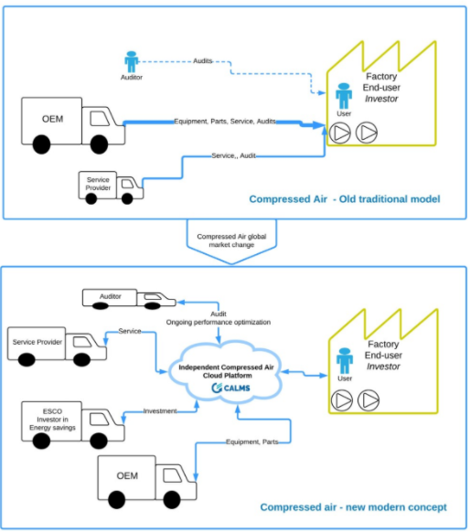
Global market change and a new concept
Merging and creating a small number of global multinational companies that drive the market
CLOUD BASED SOLUTIONS
CALMS
Notes:
Platforma je orodje in okolje za eksperte, auditorje - min.cena
Eksperti izvajajo energetske preglede, identifikacija izgub in vključijo končne uporabnike na platformo ter ponudijo kontinuirano optimizacijo
Končni uporabniki in naročniki so plačniki najemnine platforme (SaaS) in storitev energetskih strokovnjakov
Sistem je idealno orodje za identifikacijo energetskih prihrankov in ESCO podjetja, ki spremljajo investicijo in mesečne obračune energentov, ter po potrebi uporabijo storitev strokovnjakov
Dolgoročni cilj je pridobitev čim večjega števila uporabnikov, ki predstavljajo vrednost platforme za drugo fazo to je tender platforma za izbiro optimalnih ponudb glede na izbrane kriterije in oglaševanje OEM (cilj 2000 uporabnikov v 2 letih)

Slide 5
Platform users
End users - companies
-optimization of energy and personnel costs,
-supervision of suppliers, service providers and investors
-compliance with ISO directives and standards
-obtaining state incentives
-comparison with best in class, TCO, KPI
Independent experts, auditors
Sales of analysis, energy audits and solutions
ESCO - investors
Identification of savings, investment, energy sales, remote monitoring ..
Service companies - maintenance workers
Equipment suppliers - OEM
Sales of services, customer supervision, acquiring new ones, retaining existing customers, 24/7 contact
Remote control, comparative analysis, advertising of new products

Slide 6
Devices
EDGE programming interface
CALMS EDGE CS-lite audit IOT device - 3G/4G
CALMS CS-x permanent monitoring - 3G/4G
CALMS mobile app

Slide 7
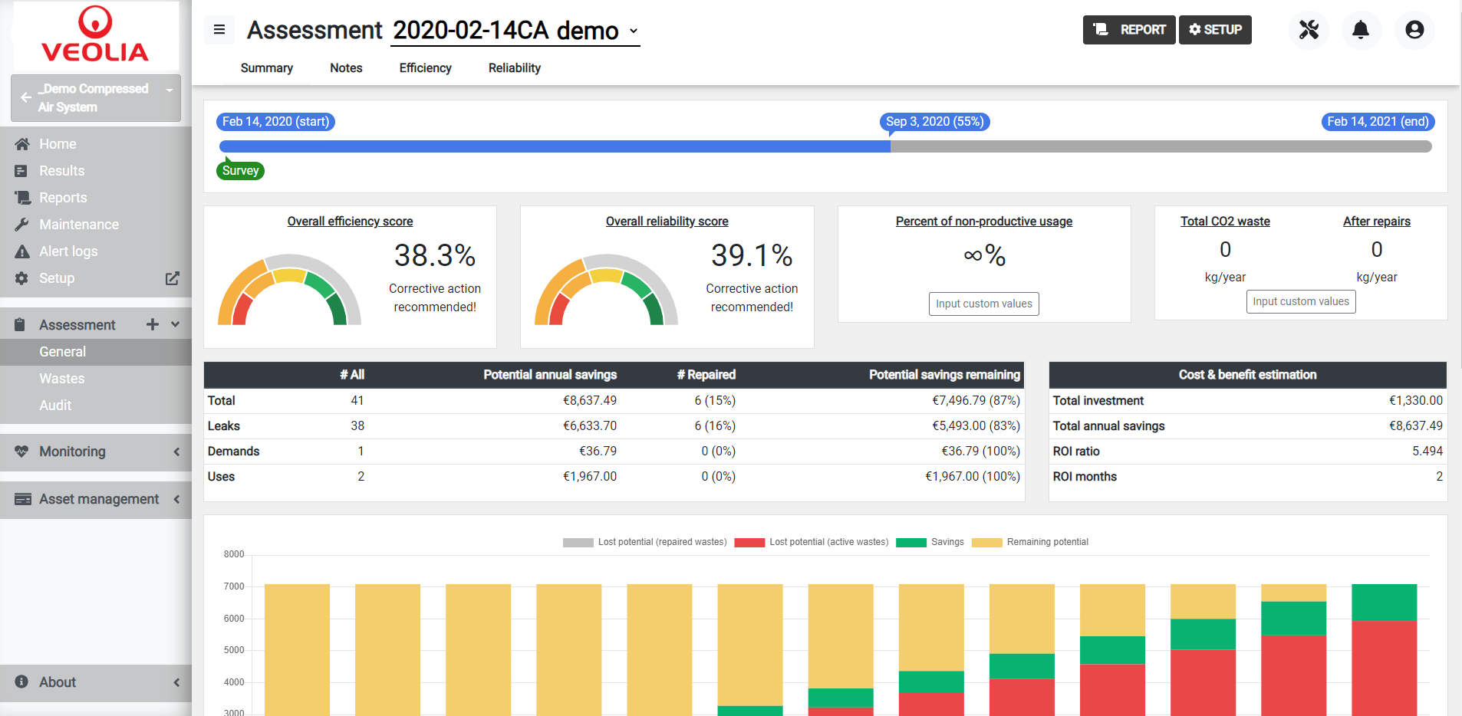
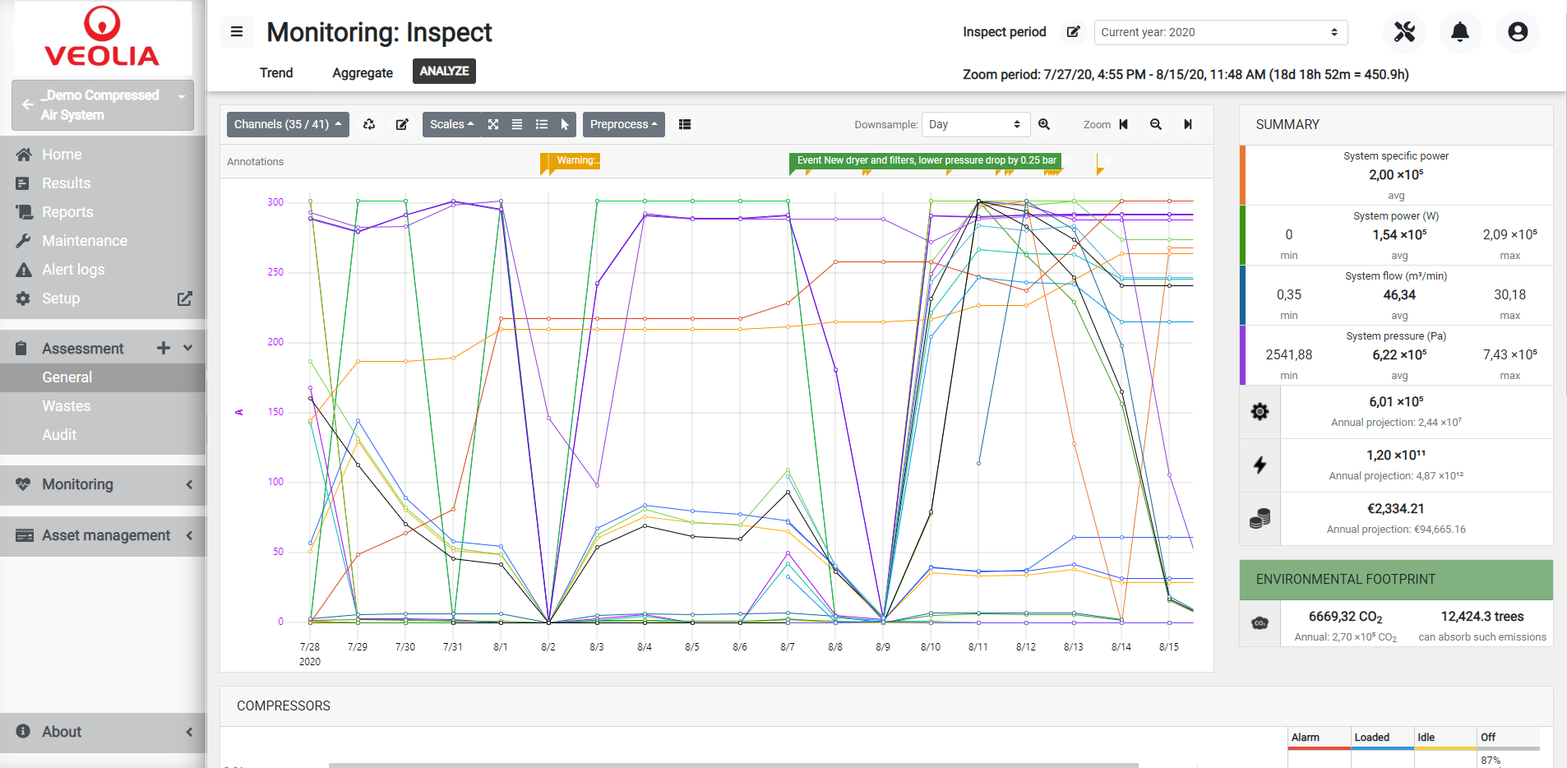
CALMS platform
System assessment and evaluation
System measurements and analysis
Continuous measurements, target monitoring of key performance indicators and service monitoring
Investment monitoring

Slide 8
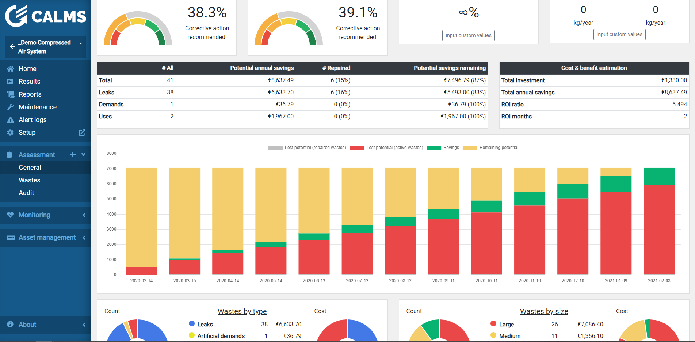
System Assessment
General
Losses
Audit

Slide 9
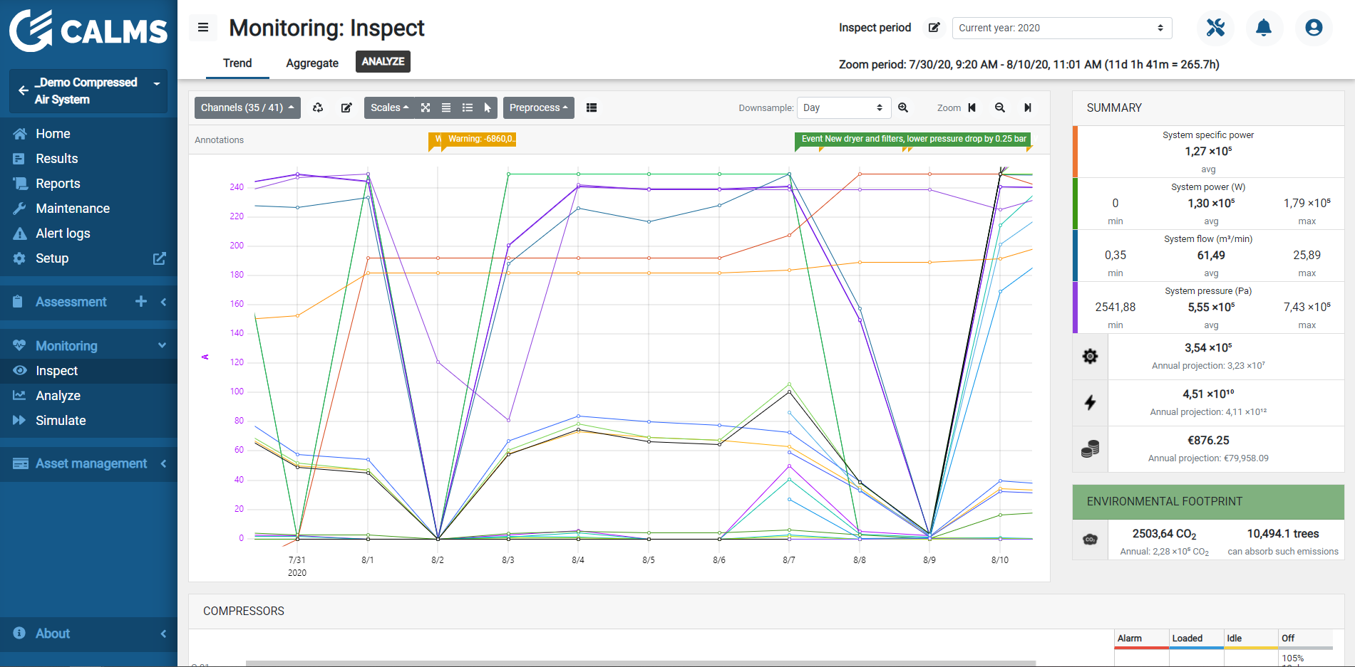
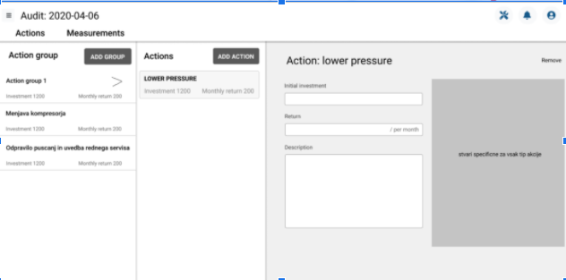
Measurements and analyzes

Slide 10
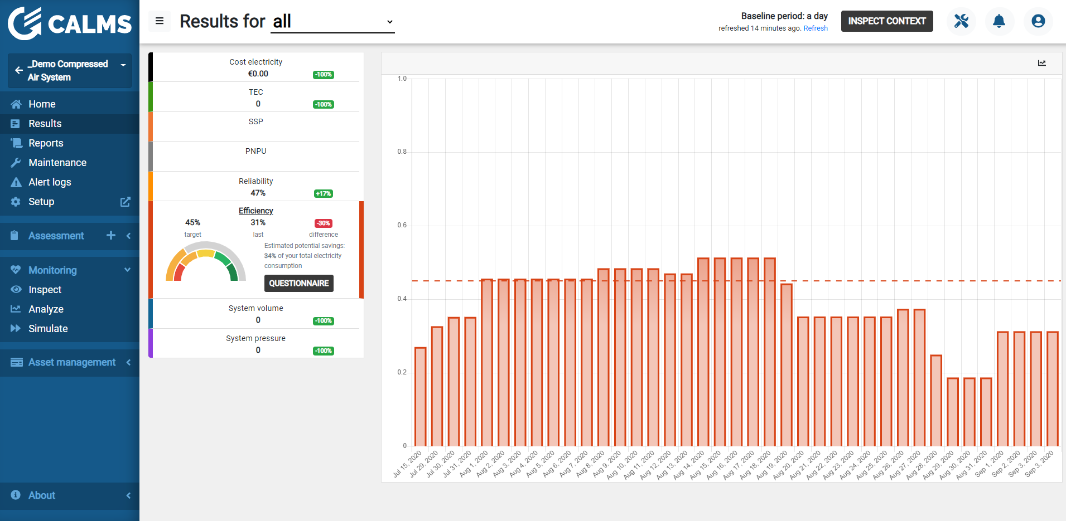
Monitoring - targeted monitoring of KPIs

Slide 11
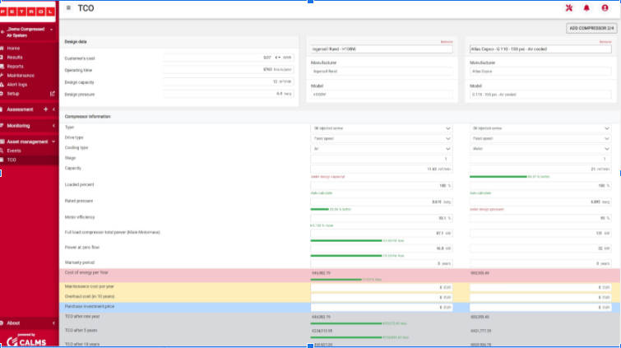
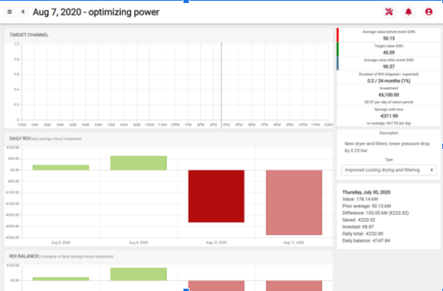
Investment monitoring
Pre-after the event
TCO
Comparison of offers

Slide 12
https://app.calms.com/

Slide 13
Customers and partners
USA, Canada
Slovenia and the former Yugoslavia, Italy, Hungary, Austria, Germany, the Netherlands, France, Spain, Poland ...
Mexico, Chile, Brazil
Australia
Experts, auditors: 25
Service companies Distributors: 40
End users: 600
ESCO: 3

Slide 14
References Worldwide

Slide 15
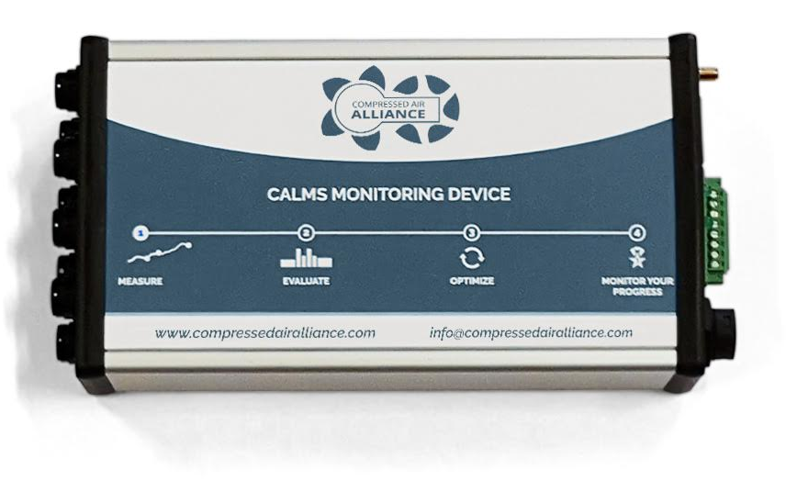
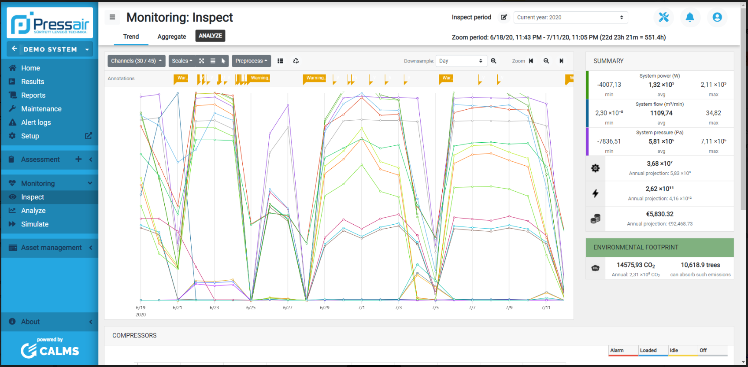
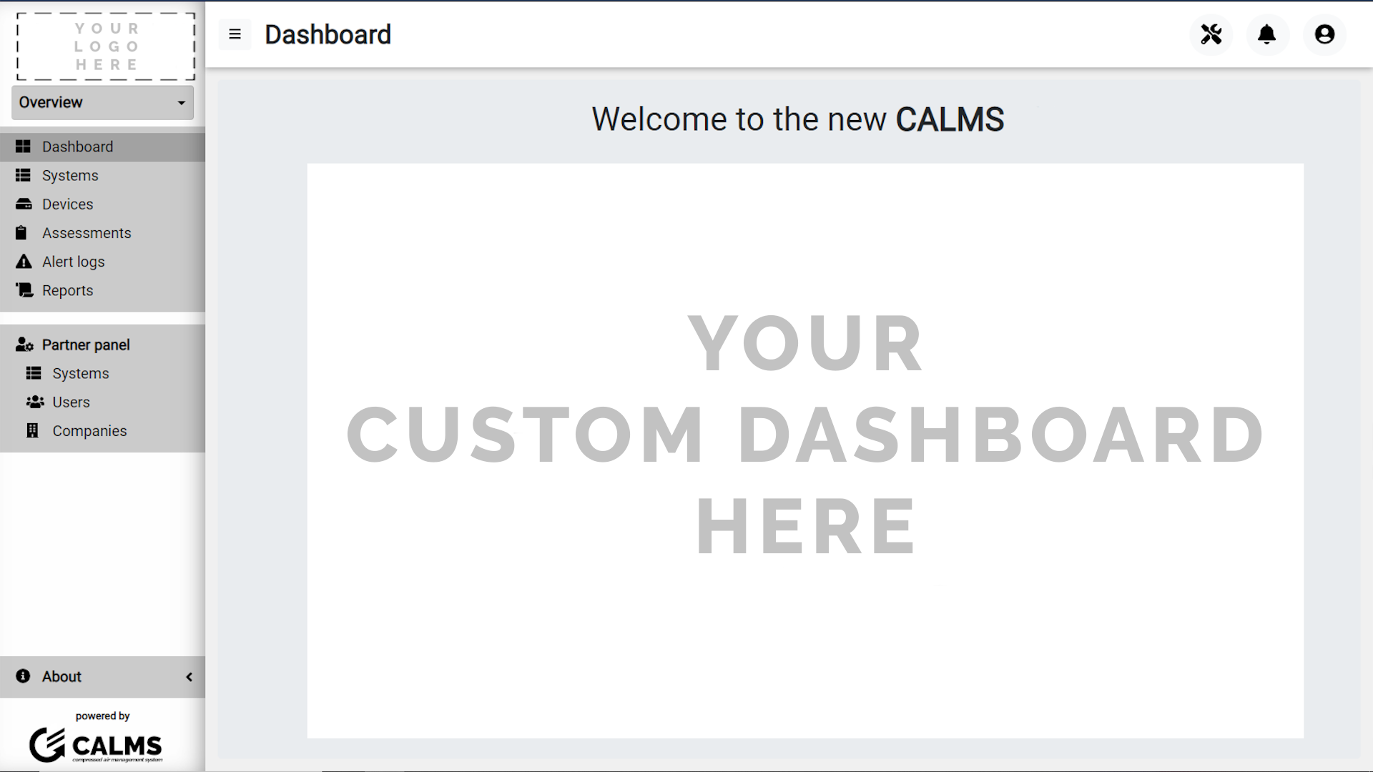
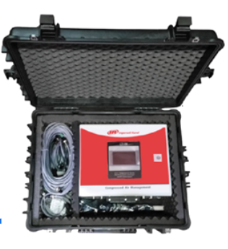
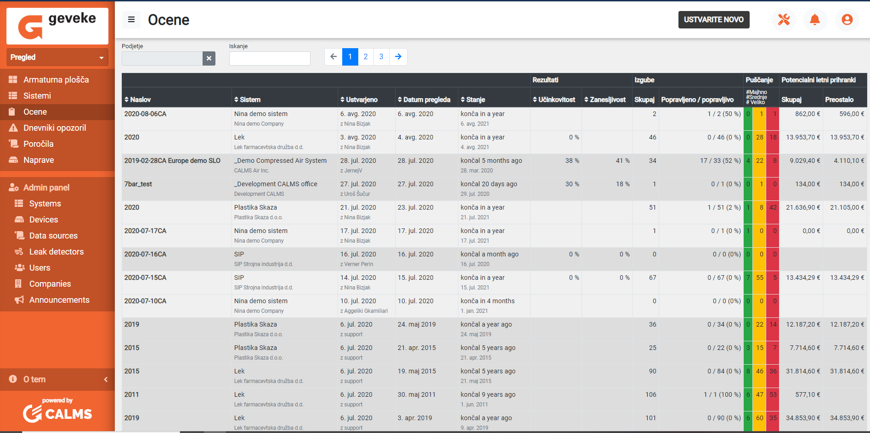
Partners with our solutions :
VPInstruments: Nizozemska
CAA Avstralija
Multibranding
Option A
Option B

Slide 16
Thank you
CALMS - energy optimisation

